Slide 1

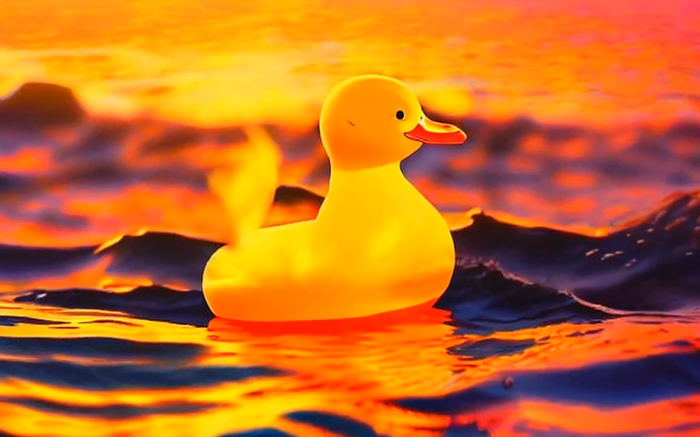
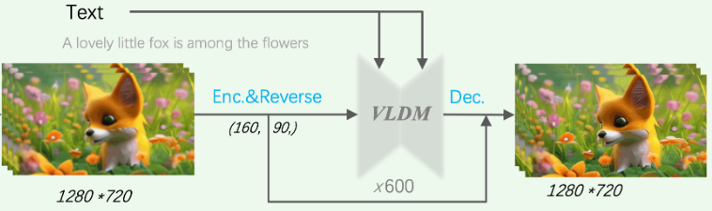
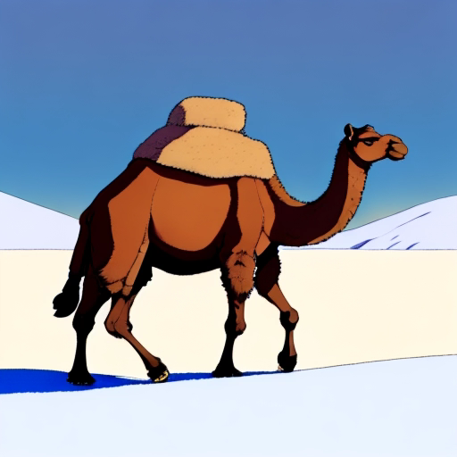
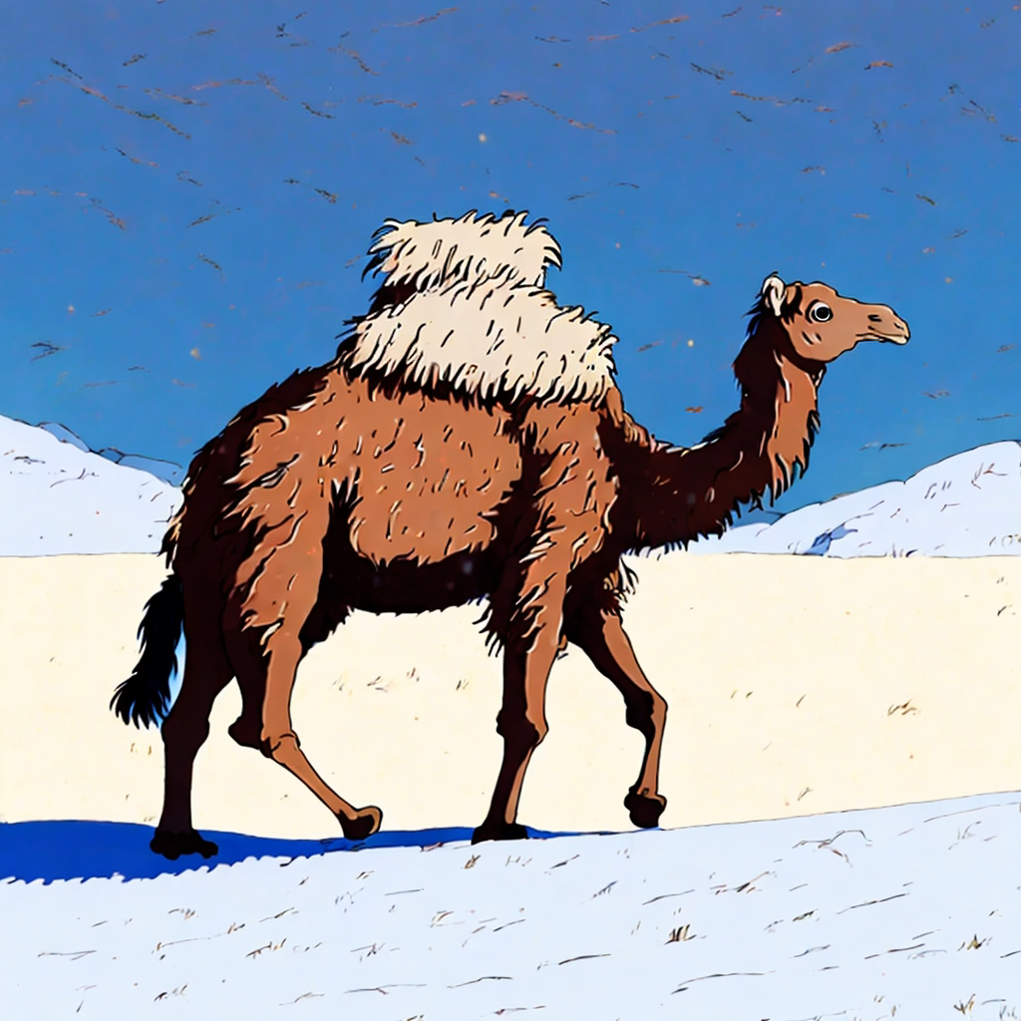
Research Background
Reference
SDEdit
Enhancement methods for videos based on SDEdit often encounter issues of altering original content or amplifying noise, whether utilizing pretrained video diffusion models or newly trained refiner models.
Impressionist style, a yellow rubber duck floating on the wave on the sunset.
Fig. Pinpline of MS-Vid2Vid-XL
To address this issue, we have devised a new formulation and found a straightforward and effective method for solving it.
A camel walking on the snow field, Miyazaki Hayao anime style.

Slide 2

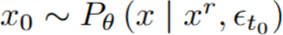
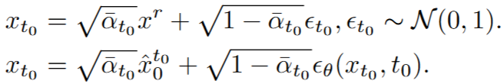
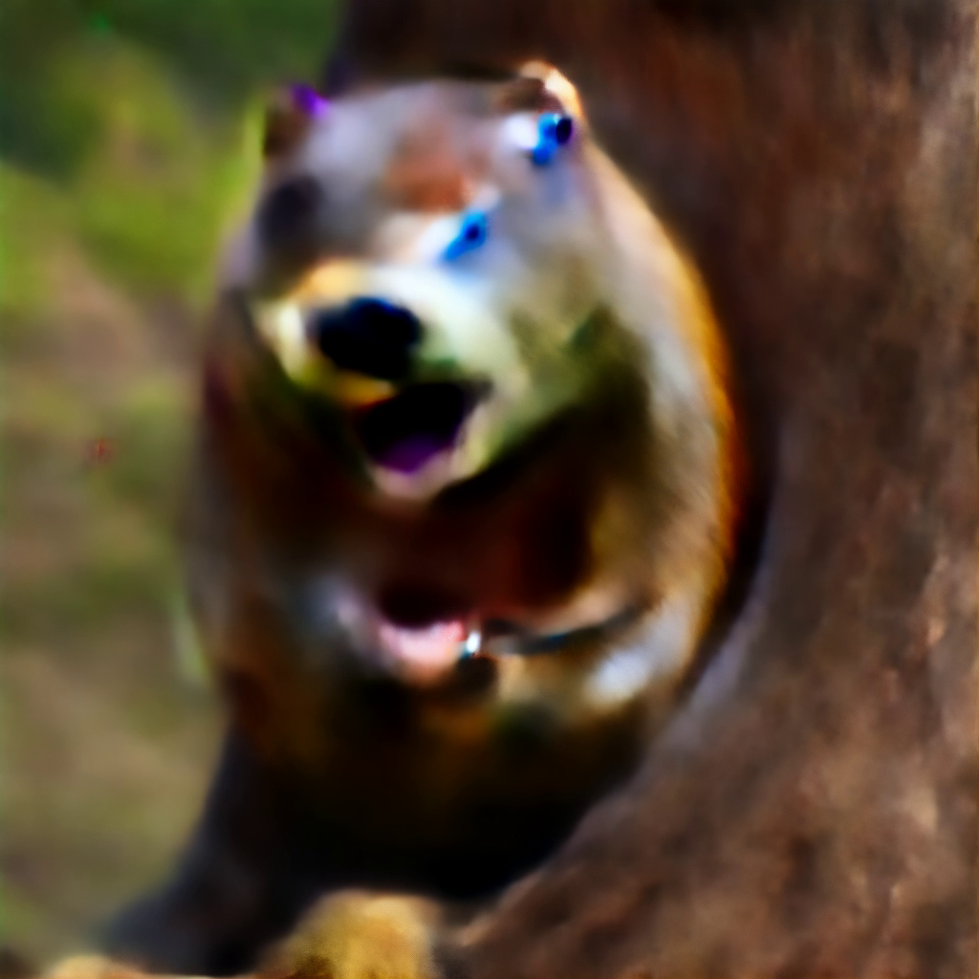
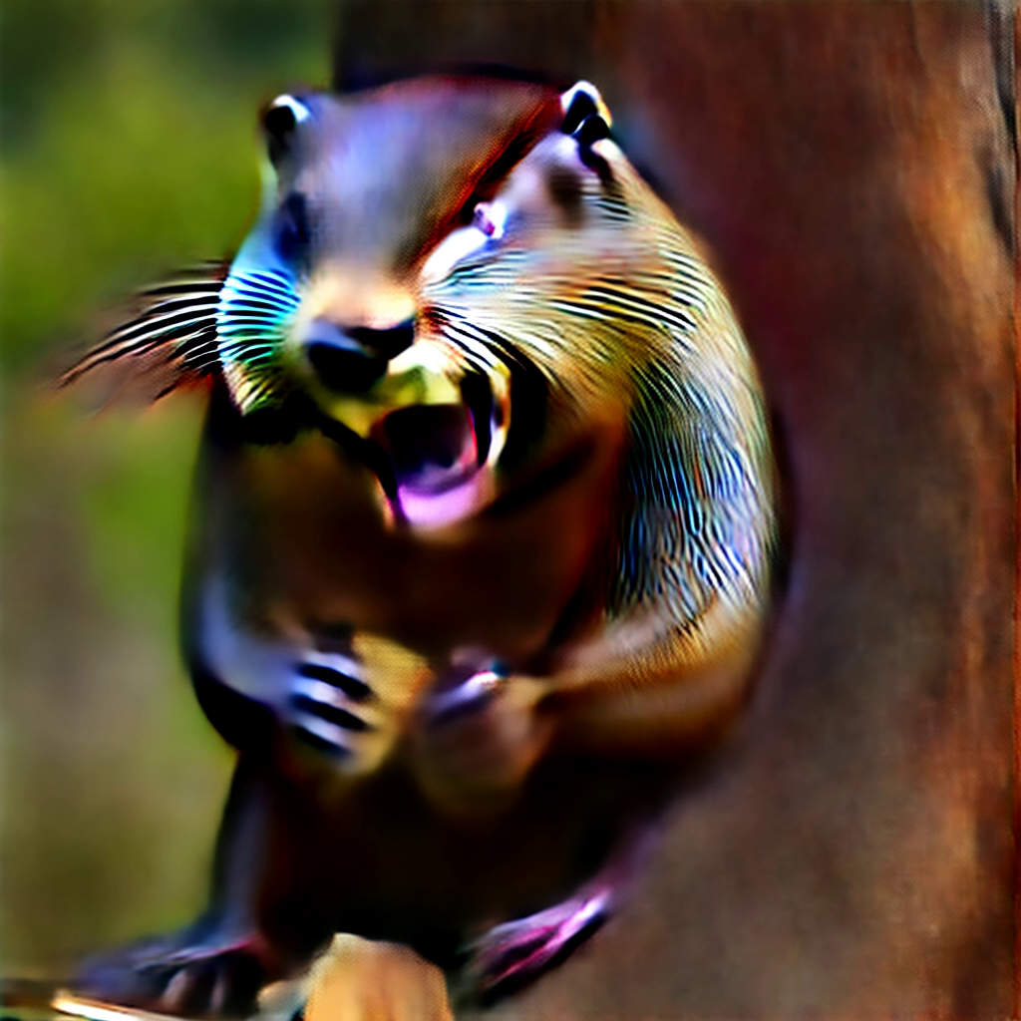
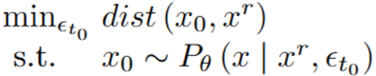
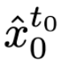
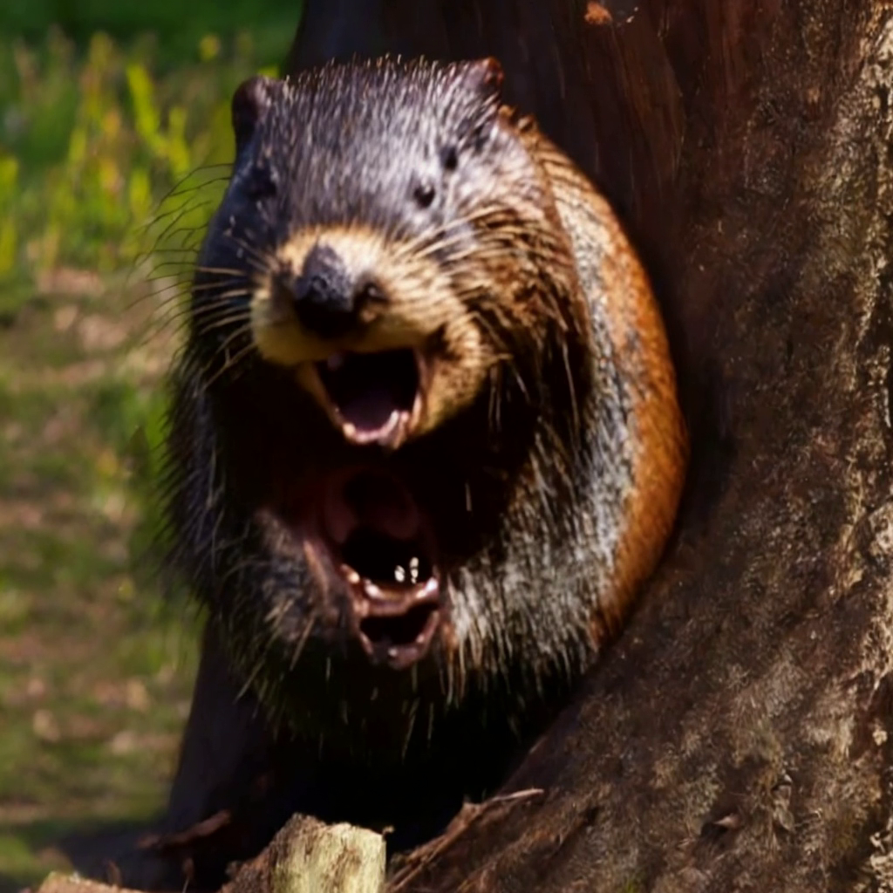

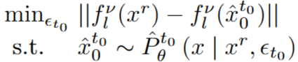
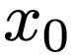
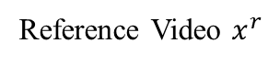
Definition of Formulation
SDEdit for video enhancement :
Reference Video $x^{r}$
Noise1
Noise2
We establish formulation to constrain content loss
Initial Estimation
the primary content loss occurs between the initial estimation and the reference video during the enhancement process. So we redefine our formulation as follows:
Final Result

Slide 3
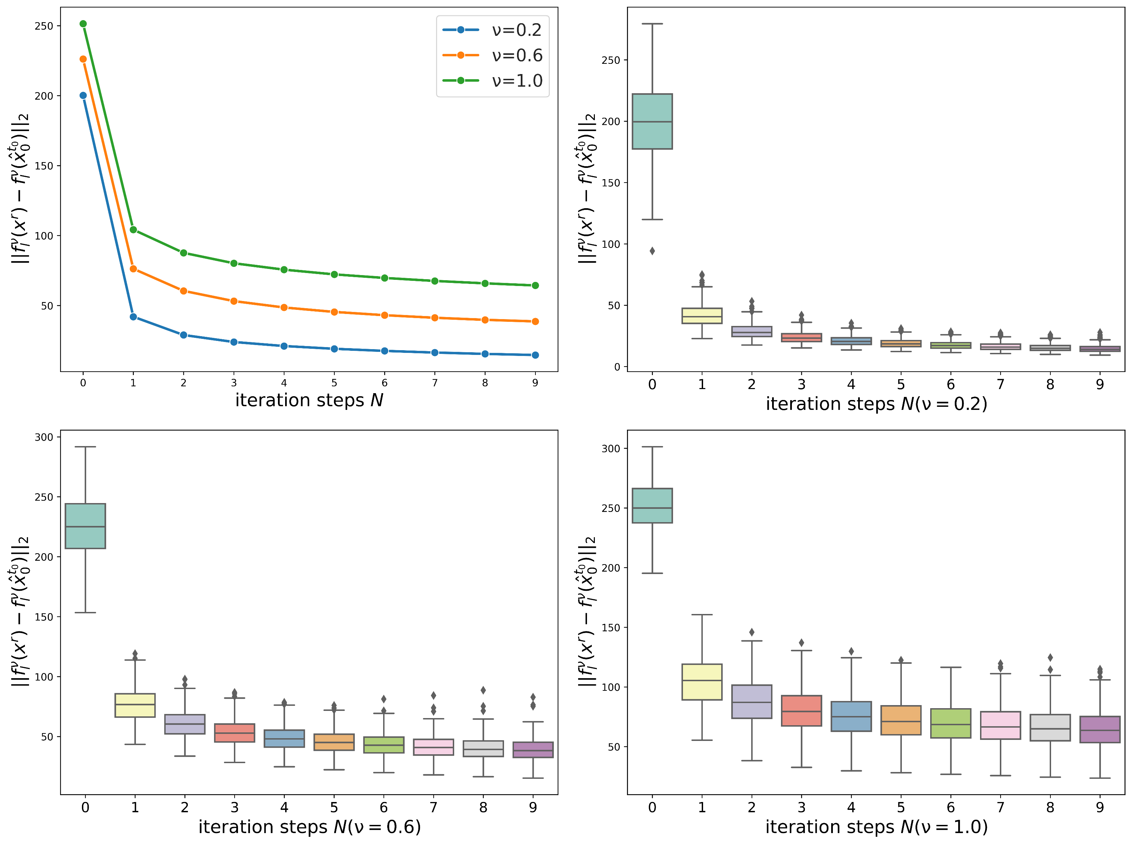
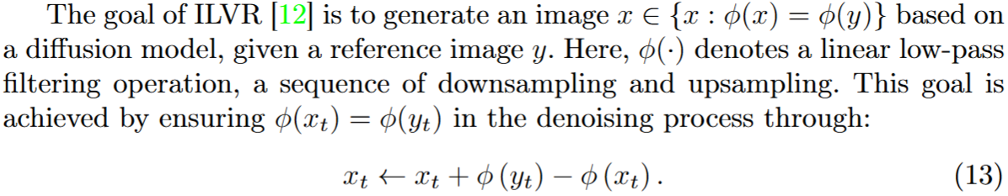
Solution to Formulation
Transformation of the optimisation objective
Optimisation based on Fixed Point Iteration
1) Essential Relationship with ILVR
2) Experimental verification of convergence
Essentially, during each iteration, a replacement on the low-frequency domain resembling LIVR as:

Slide 4
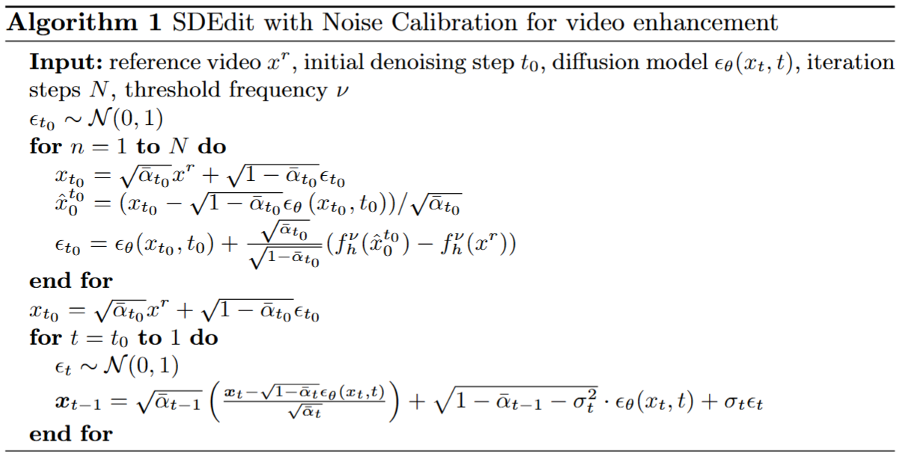
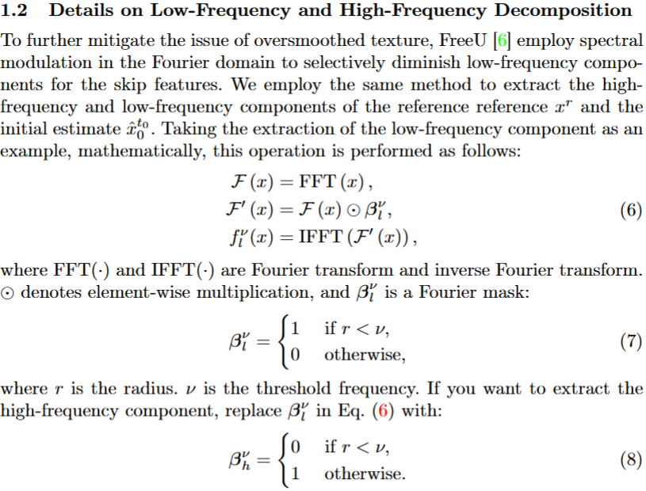
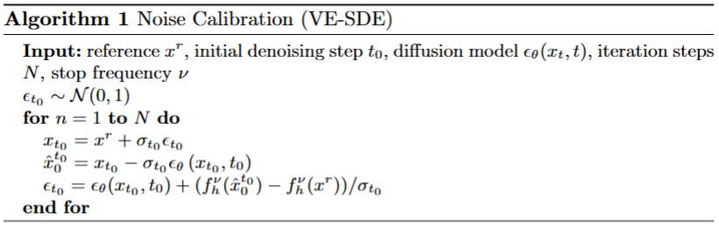
Noise Calibration

